Slide 1
CSC 220
Advanced Programming
Topic: uml diagram

Slide 2
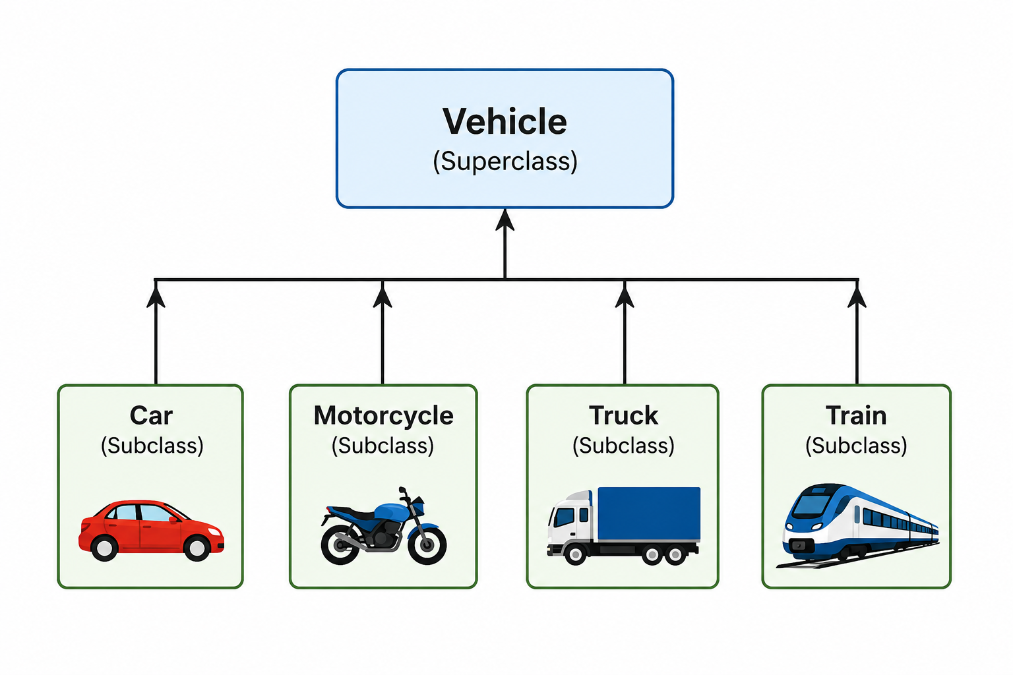
is-a relationship: inheritance

Slide 3
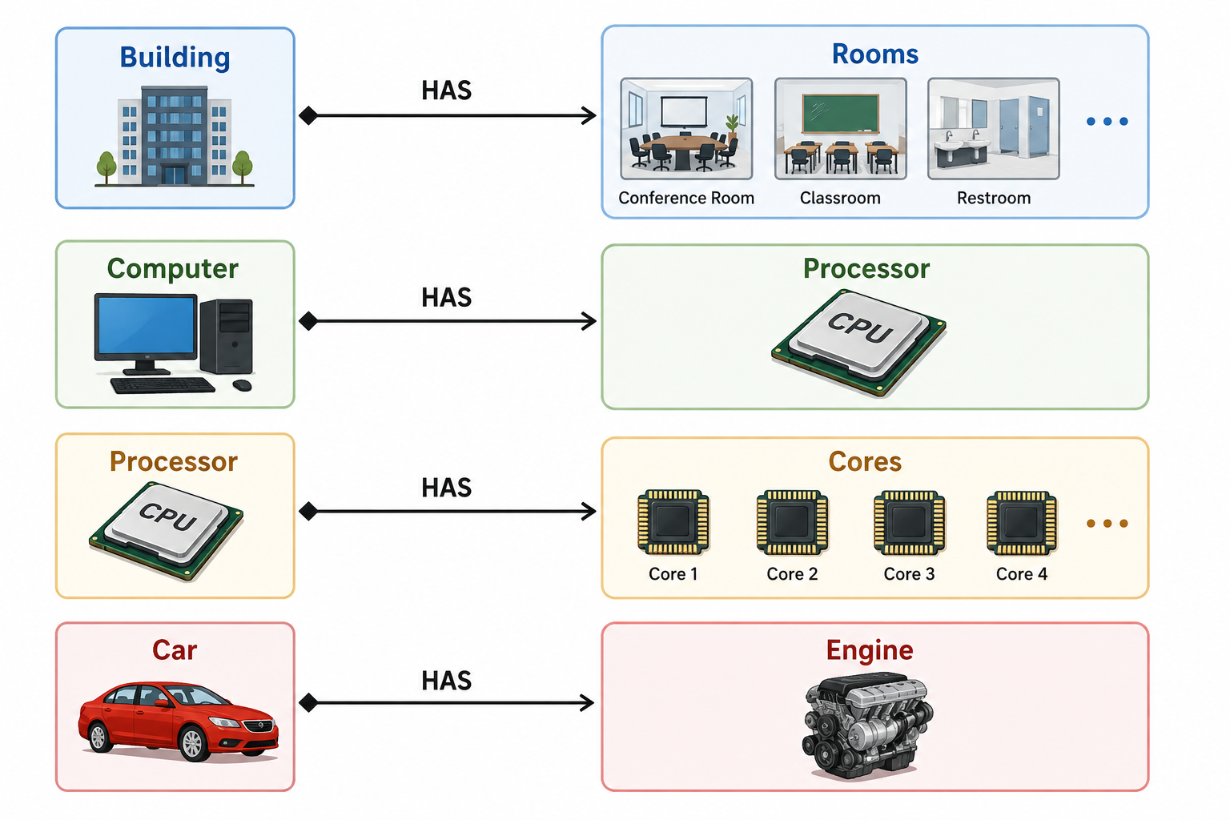
Not only through inheritance

Slide 4
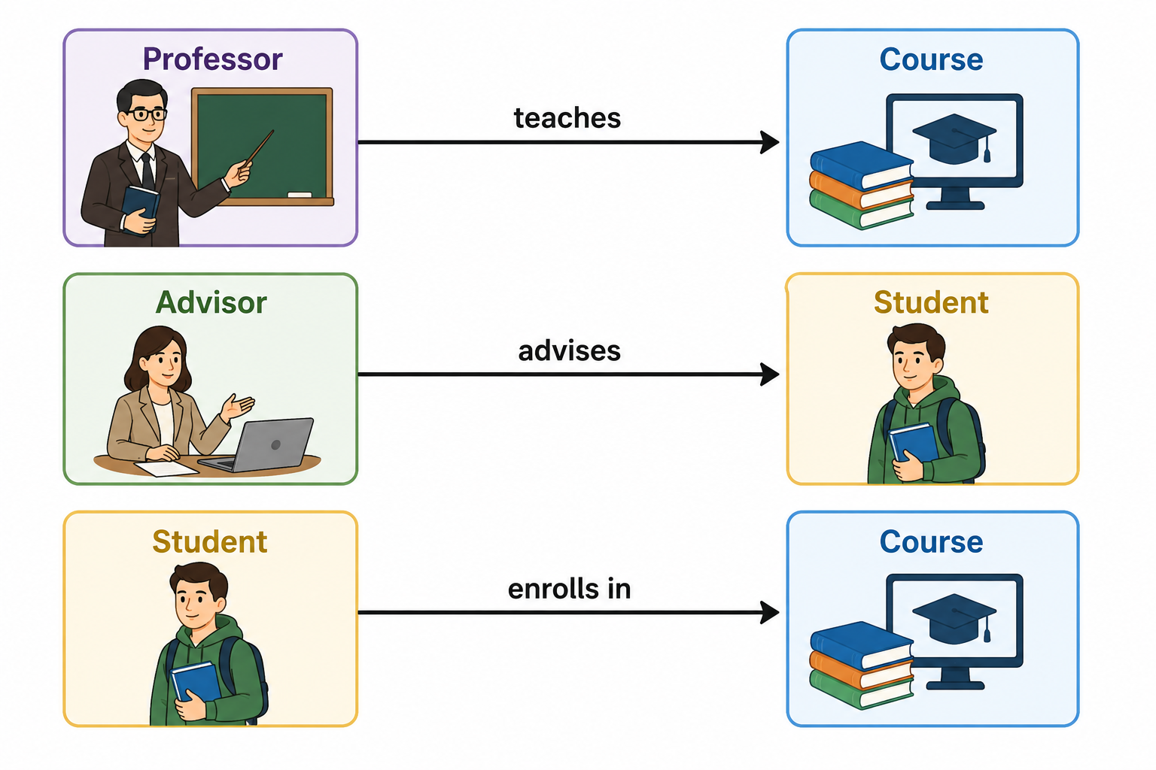
Wait! There are more ...

Slide 5
Various forms of relations
We use associations to represent these kinds of relationships between objects.
Association → Aggregation → Composition

Slide 6
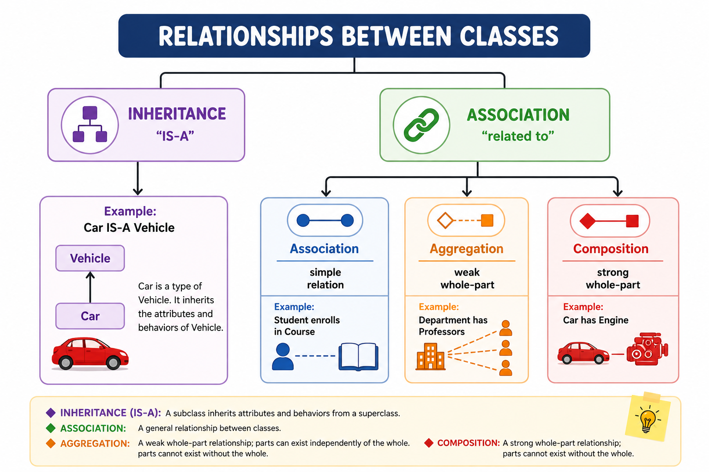

Slide 7
Multiplicity
Multiplicity = how many instances of one class may be associated with one instance of another class.
Student * -------- 1 Advisor [many to one]
  Many students may have the same advisor
  An advisor may have many assigned advisees/students
  This expresses a many-to-one relationship between Student and Advisor.

Slide 8
Multiplicity
Multiplicity = how many instances of one class may be associated with one instance of another class.
Student * -------- 1 Advisor [many to one]
Student * -------- * Course [many to many]
Professor * ------- * Course [many to many]
Adult 1 -------- 1 SSN [one to one]

Slide 9
Your Turn ...
An example of a
  Association
  Aggregation
  Composition
  1 to 1
  1 to many
  Many to many

Slide 10
Be the Designer/ PM
Now imagine that you are the designer or project manager of a software project.

Slide 11
How to communicate?
You have talked with the client, analyzed the problem, and identified some potential classes.
You have also identified relationships among those classes.
Now you need to communicate this design to your development team.

Slide 12
What's the caveat?
In the system,
We need a Student class,
a Course class, and
a Professor class.
Students enroll in courses.
Professors teach courses.
A course may have many students...”

Slide 13
Potential Alternatives?
What if we could draw the system instead?
What if, in one picture, we could show:
  the important classes,
  what information they contain,
  what they can do,
  how they are related,
  even the multiplicity of those relationships?
Then another developer could look at the picture and quickly understand the structure of the system—and potentially notice missing or incorrect relationships before we even start coding.

Slide 14
UML <Unified Modeling Language>
Large-scale systems contain thousands of interacting components, and visual models; we need to break these down into manageable structural and behavioral views.
  UML provides a universal notation system that bridges communication gaps between technical teams, stakeholders, and non-technical managers
  Designing through models allows developers to spot structural flaws, circular dependencies, or architectural bottlenecks before writing a single line of code
  Models support both planning applications ahead of time (forward design) and documenting existing codebases for future maintenance (backward design).

Slide 15
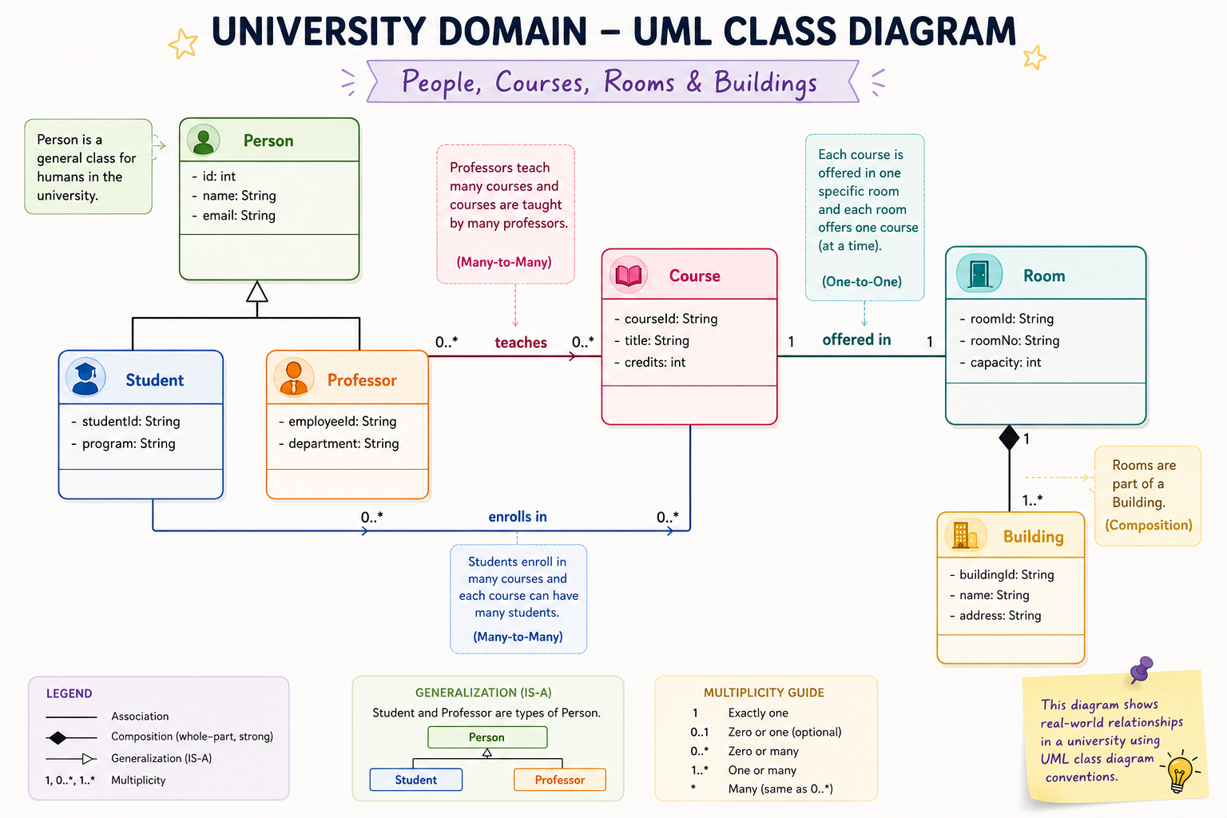

Slide 16
Samples
https://www.jointjs.com/blog/uml-class-diagrams
https://www.visual-paradigm.com/guide/uml-unified-modeling-language/uml-class-diagram-tutorial/ [10~ 15 minutes]
UML is not the program. UML is a way to communicate and reason about the design of the program before—or while—we build it.

Slide 17
Activity: “Design the University Tech Hub”

